Slide 1
K-Nearest Neighbor(KNN)
Prepared by
Popy das

Slide 2
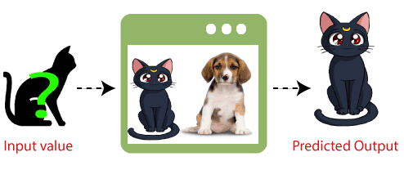
Definition
A K-Nearest-Neighbor algorithm, often abbreviated K-NN, is an approach to data classification that estimates how likely a data point is to be a member of one group or the other depending on what group the data points nearest to it are in.
Supervised
Classification and Regression
Non-parametric Algorithm
Lazy Learner Algorithm

Slide 3
How does K-NN work?
Step-1: Select the number K of the neighbors
Step-2: Calculate the Euclidean distance of K number of neighbors
Step-3: Take the K nearest neighbors as per the calculated Euclidean distance
Step-4: Among these k neighbors, count the number of the data points in each category
Step-5: Assign the new data points to that category for which the number of the neighbor is maximum
Step-6: Our model is ready

Slide 4
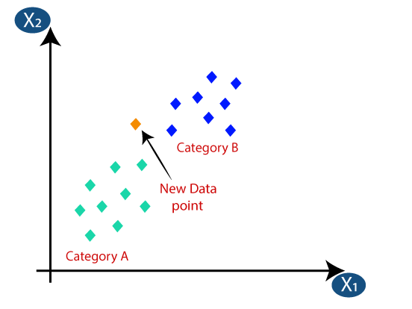
Simulation

Slide 5
Step 1
Firstly, we will choose the number of neighbors, so we will choose the k=5.
There is no particular way to determine the best value for "K", so we need to try some values to find the best out of them. The most preferred value for K is 5.
A very low value for K such as K=1 or K=2, can be noisy and lead to the effects of outliers in the model.
Large values for K are good, but it may find some difficulties.
Try to take odd value.

Slide 6
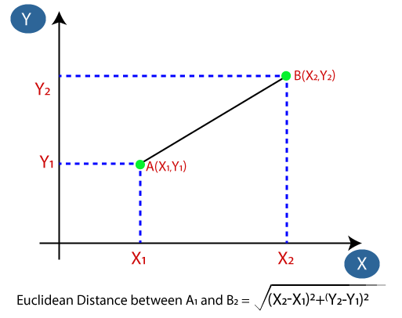
Step 2
We will calculate the Euclidean distance between test data and each row of training data. The Euclidean distance is the distance between two points. It can be calculated as:

Slide 7
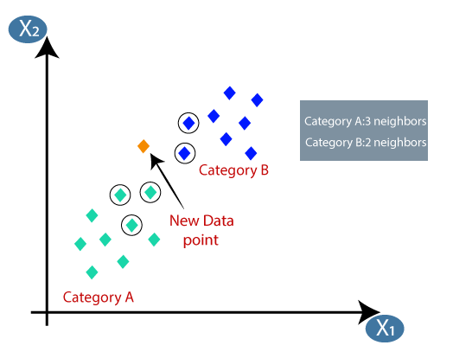
Step 3
By calculating the Euclidean distance we got the nearest neighbors, as three nearest neighbors in category A and two nearest neighbors in category B.

Slide 8
Step 4: As we can see the 3 nearest neighbors are from category A and 2 nearest neighbors are from category B.
Step 5: As we can see the 3 nearest neighbors are from category A, hence this new data point must belong to category A.
Step 6: Our model is ready.

Slide 9
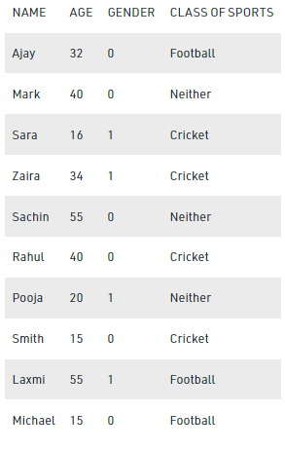
Mathematical Explanation
Here male is denoted with numeric value 0 and female with 1.
Let’s find in which class of people Angelina will lie whose age is 5 and female.

Slide 10
Step By Step Process
Step 1: How do we choose K?
Sqrt(n), where n is a total number of data points(if in case n is even we have to make the value odd by adding 1 or subtracting 1 that helps in select better).
Here, n = 10. so, k = sqrt(10) = 3
Step 2: we have to find out the distance using
d=√((x2-x1)²+(y2-y1)²) to find the distance between any two points.
So let’s find out the distance between Ajay and Angelina using formula
d=√((age2-age1)²+(gender2-gender1)²
d=√((5-32)²+(1-0)²)
d=√729+1
d=27.02

Slide 11
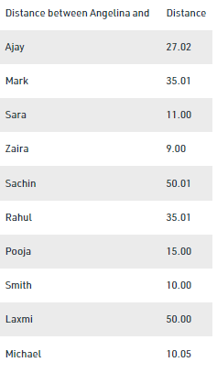
Similarly, we find out all distance one by one.

Slide 12
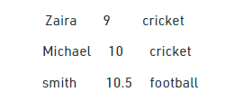
Step 3: The value of k factor is 3 for Angelina. And the closest to 3 is 9,10,10.5 that is closest to Angelina are Zaira, Smith and Michael.
Step 4: So according to KNN algorithm, Angelina will be in the class of people who like cricket. So this is how KNN algorithm works.

Slide 13
Application
Banking System
Calculating Credit Ratings
Politics
Medical
Facial recognition
Recommandation systems (Amazon, Hulu, Netflix etc.)

Slide 14
Advantages
It is simple to implement.
It is robust to the noisy training data.
It can be more effective if the training data is large.
It is very useful for nonlinear data because there is no assumption about data in this algorithm.
It is a versatile algorithm as we can use it for classification as well as regression.

Slide 15
Disadvantages
It is computationally a bit expensive algorithm because it stores all the training data.
High memory storage required as compared to other supervised learning algorithms.
Always needs to determine the value of K which may be complex some time.
The computation cost is high because of calculating the distance between the data points for all the training samples.

Slide 16
References
https://www.javatpoint.com/k-nearest-neighbor-algorithm-for-machine-learning
https://www.youtube.com/watch?v=L5RUA2_eCIg&t=12s
https://medium.com/@arman_hussain786/k-nearest-neighbors-knn-and-its-applications-7891a4a916c6

